Slide 3
Pimps do what they want to do.
Hoes do what they’re told.
Squares do what they can.
- Payroll

Slide 4
Power does what it wants to do.
Panic does what its told.
Pleasure does what it can.

Slide 5
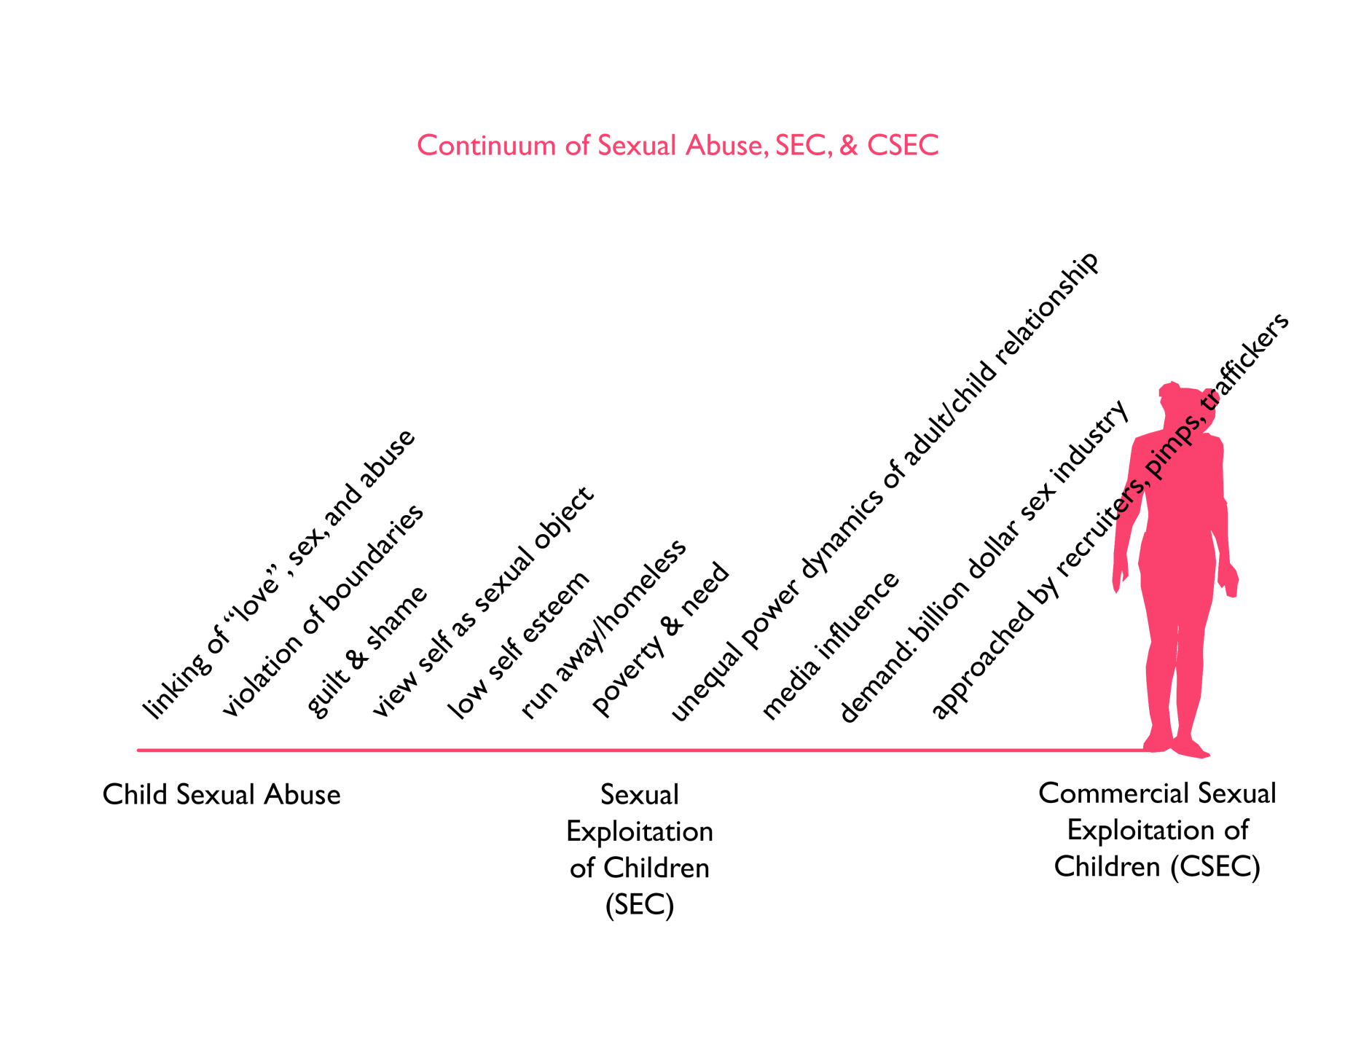
PROMISE

Slide 6
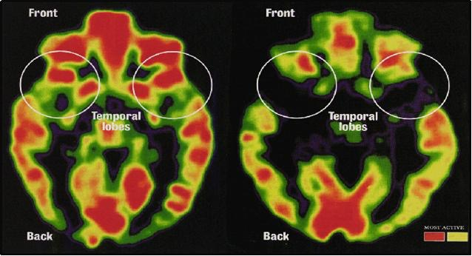

Slide 8
PROMISE

Slide 9
Empathy
Agency
Urgency

